Slide 1


First Year Mass of Welcome

Slide 2
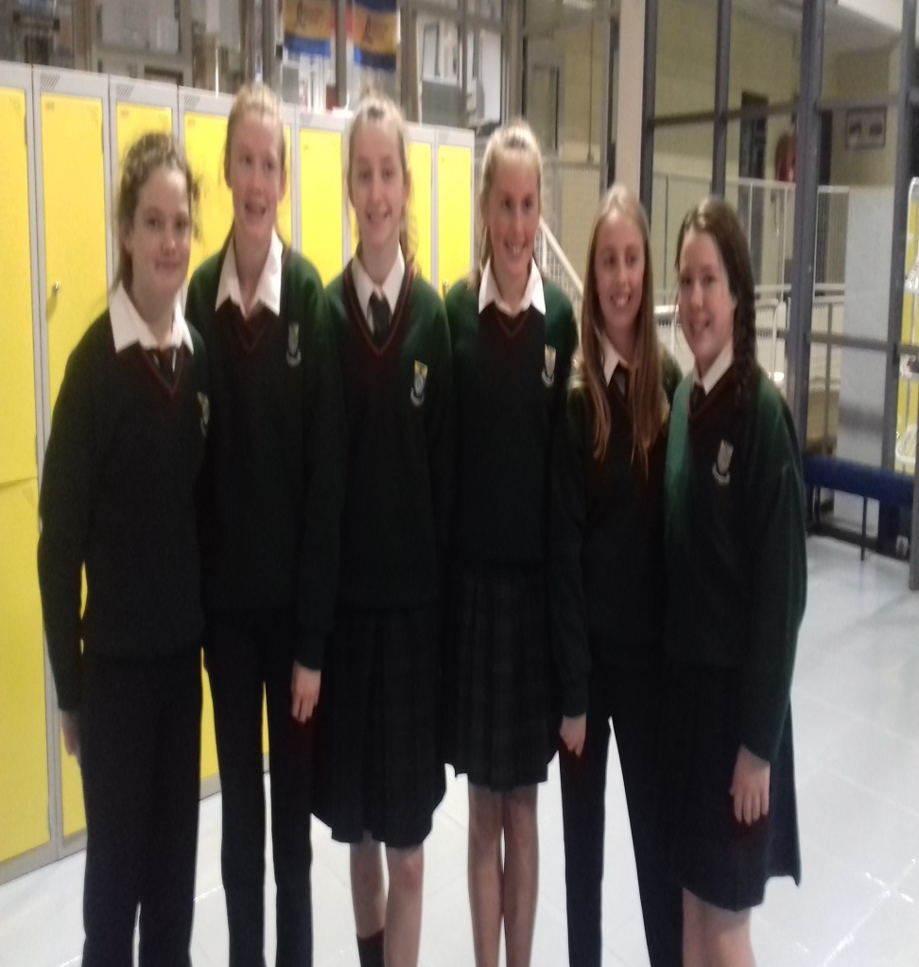
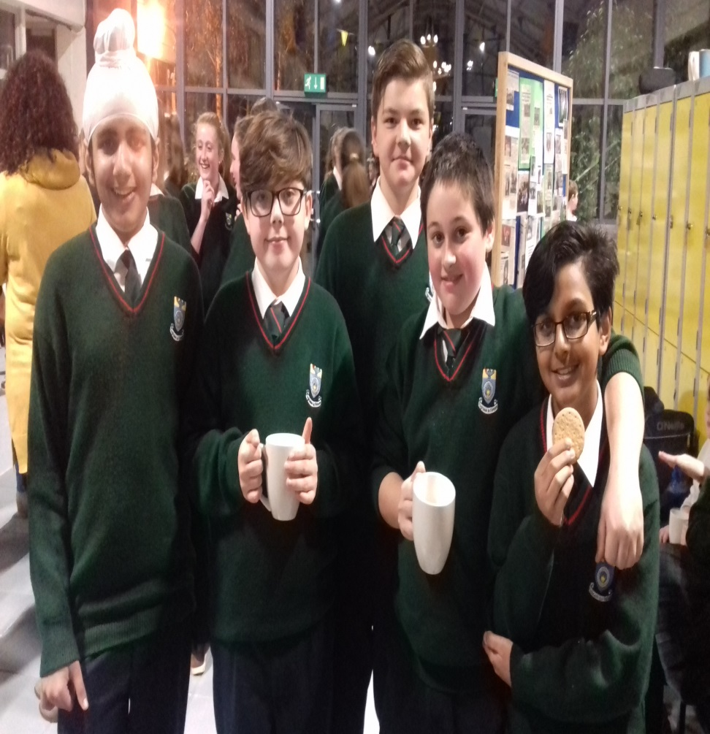
First Year Mass of Welcome

Slide 3
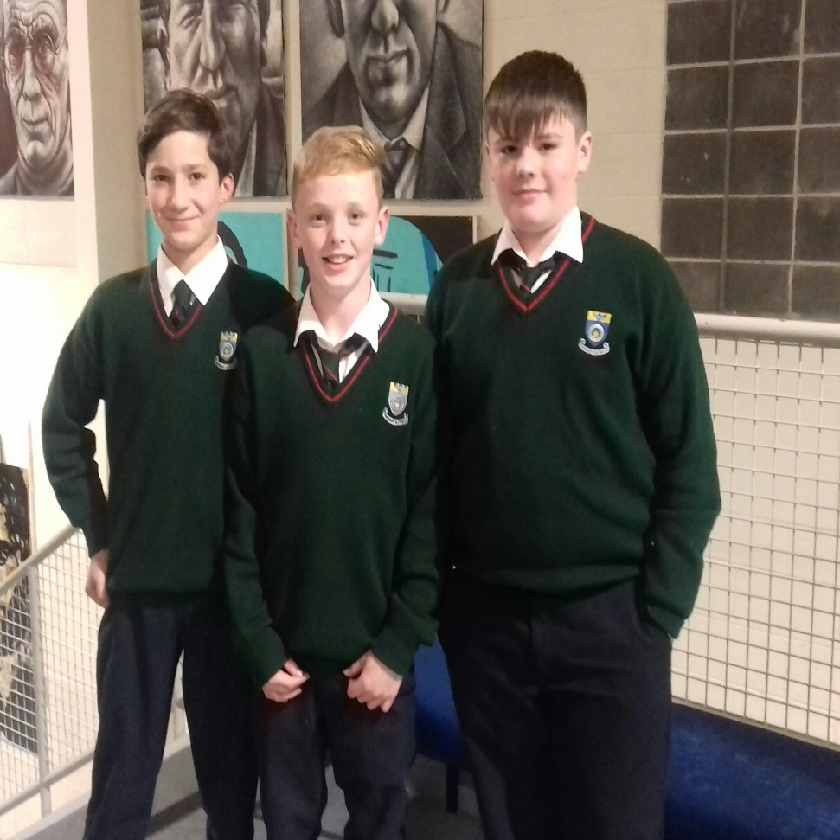
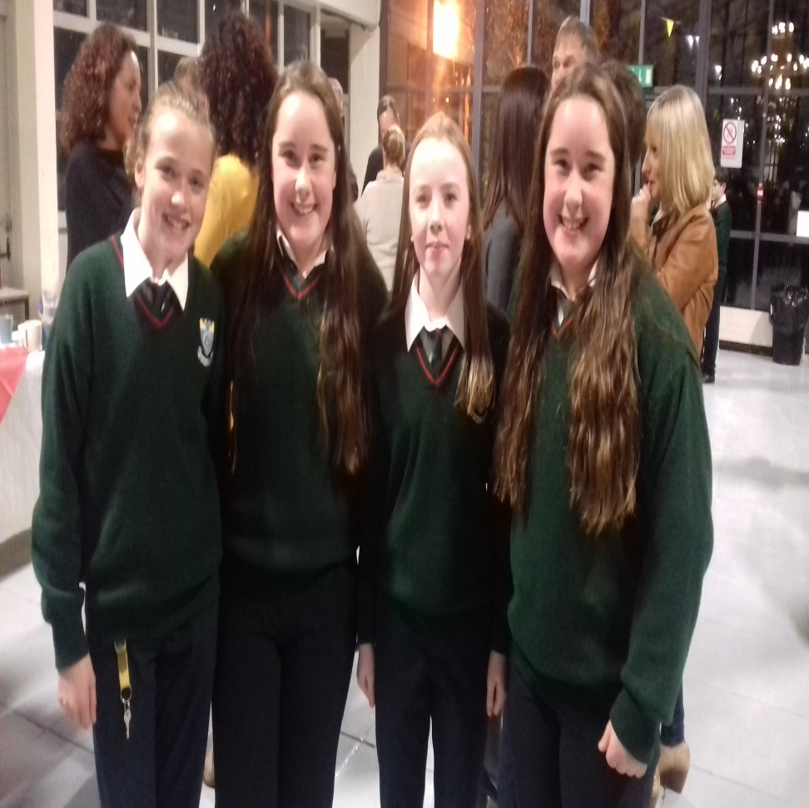
First Year Mass of Welcome

Slide 4
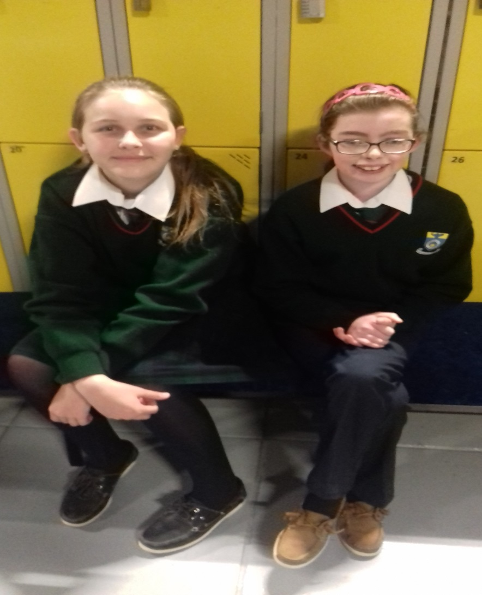
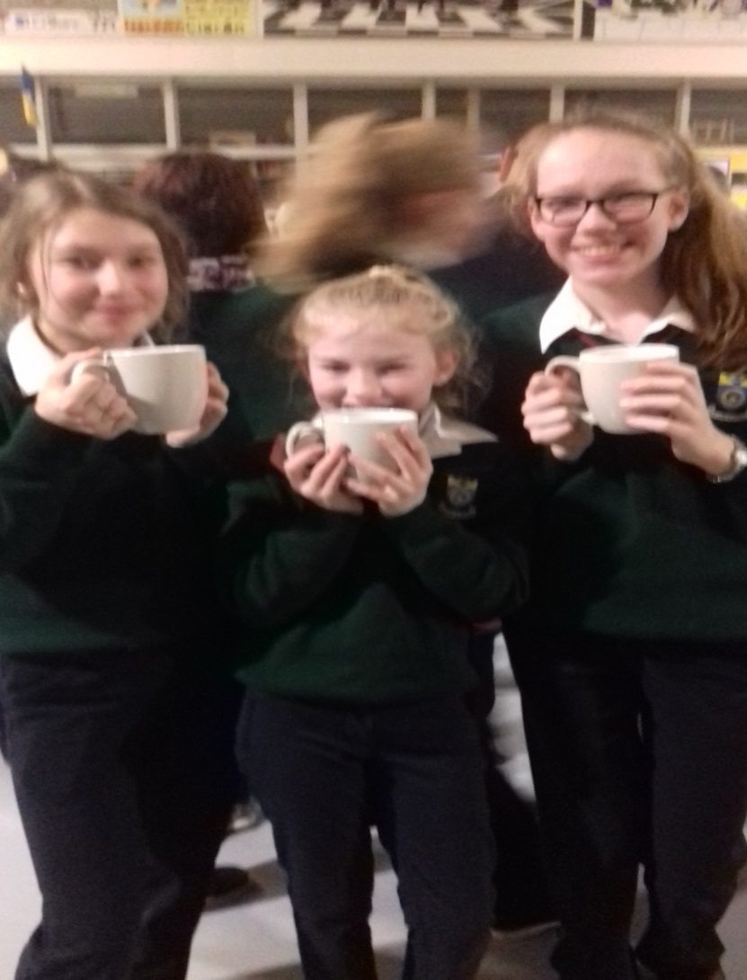
First Year Mass of Welcome

Slide 5
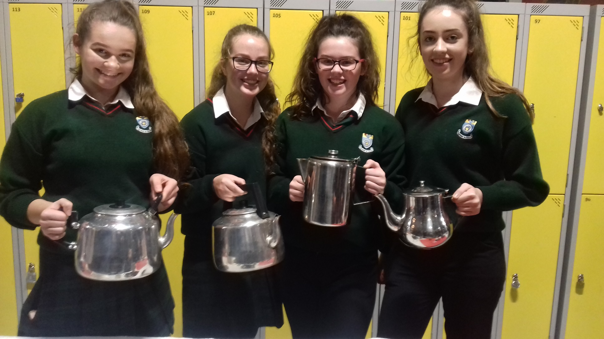
TY Volunteers for Welcome Mass

Slide 6
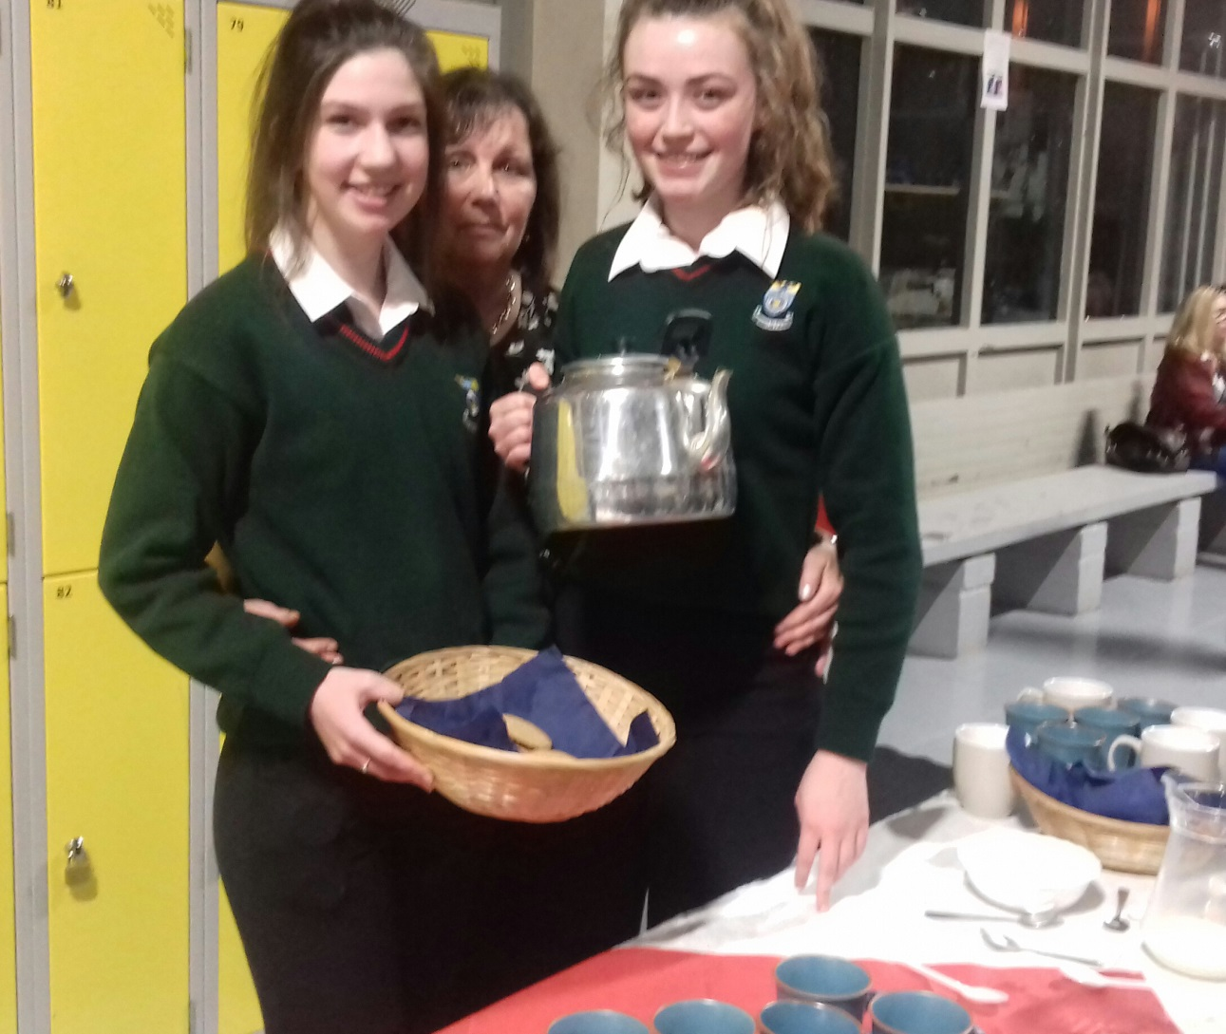
TY Volunteers for Welcome Mass

Slide 7
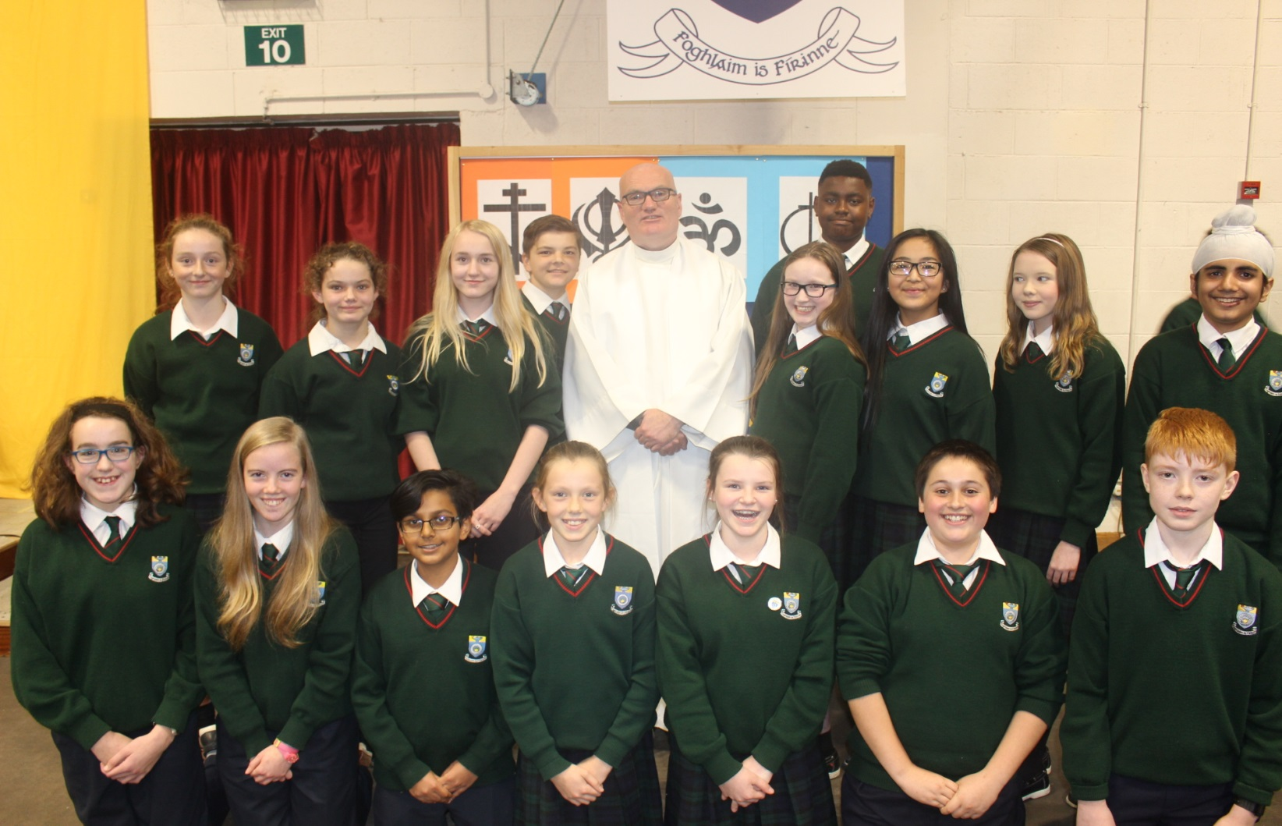
First Year Mass of Welcome

Slide 8
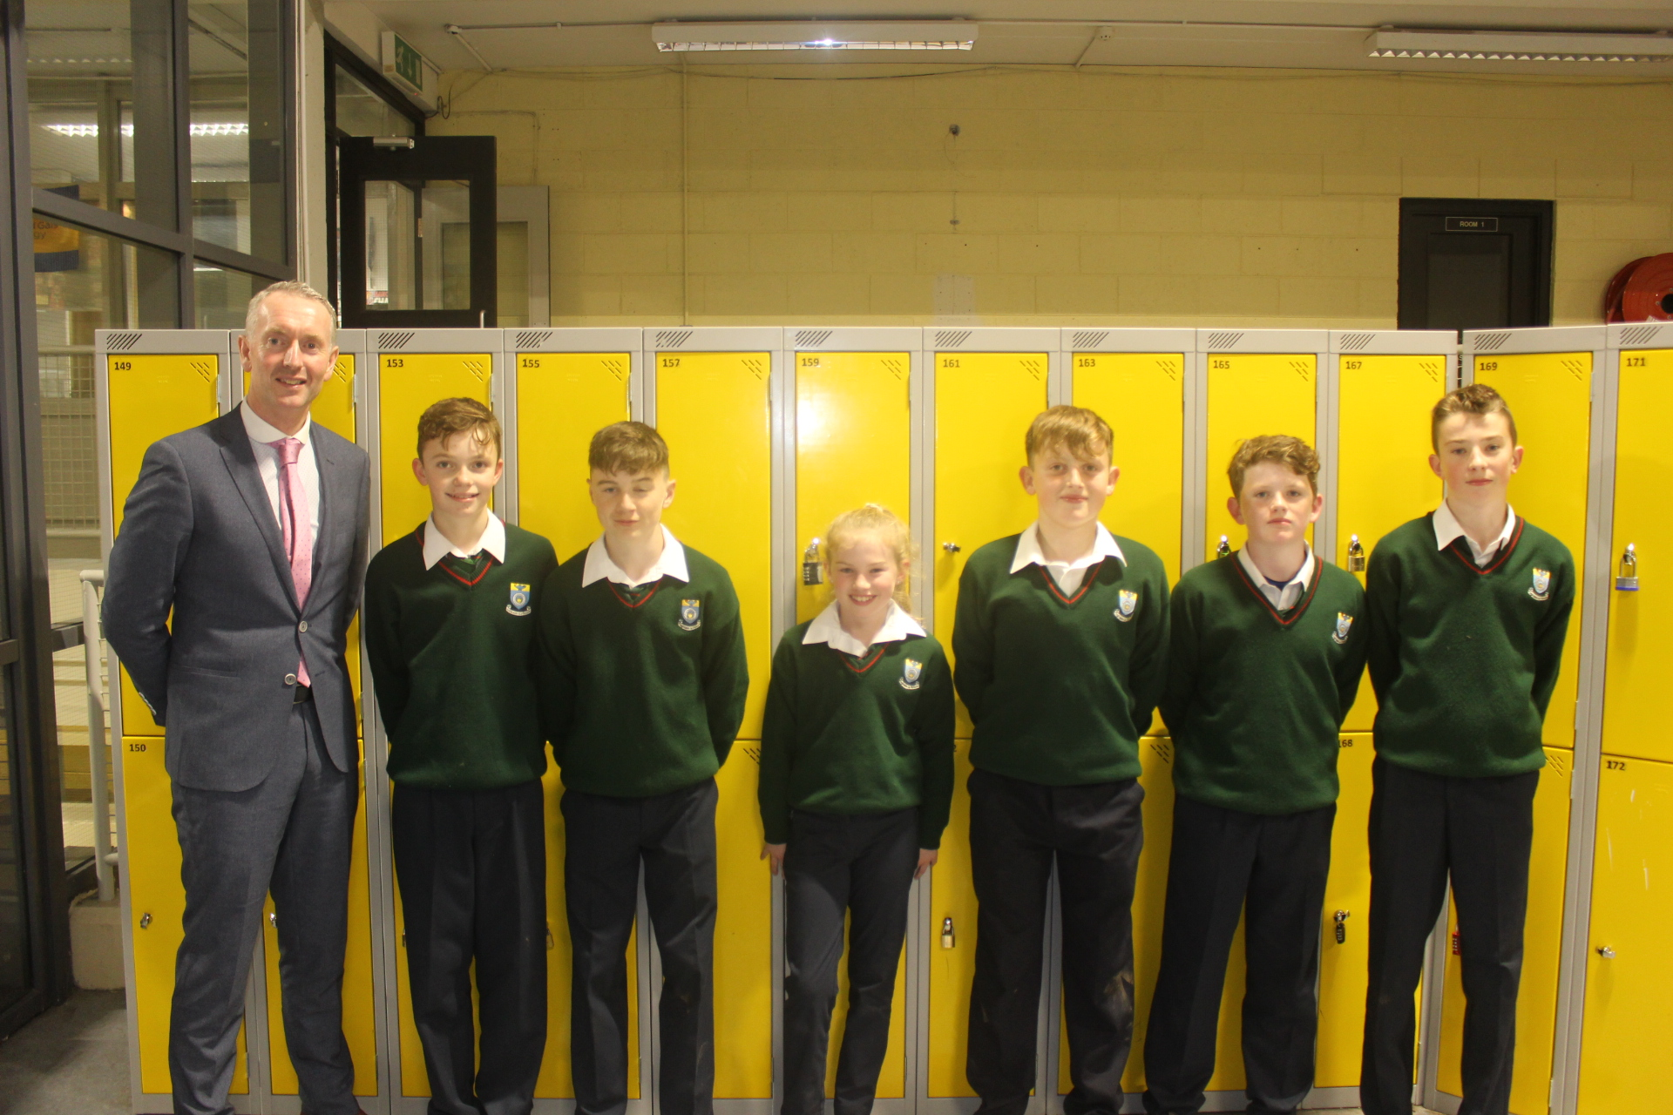
First Year Mass of Welcome

Slide 9
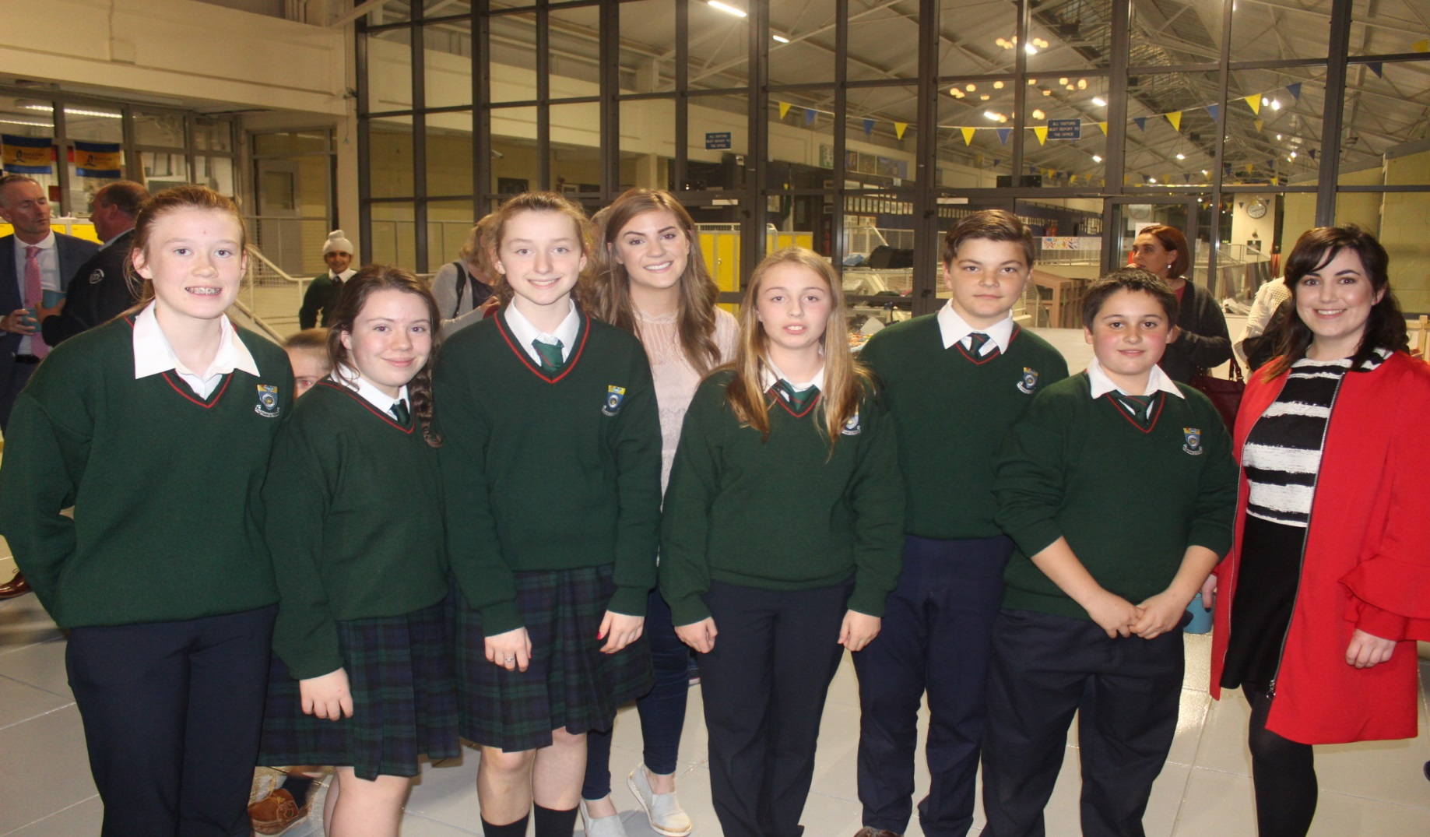
First Year Mass of Welcome

Slide 10
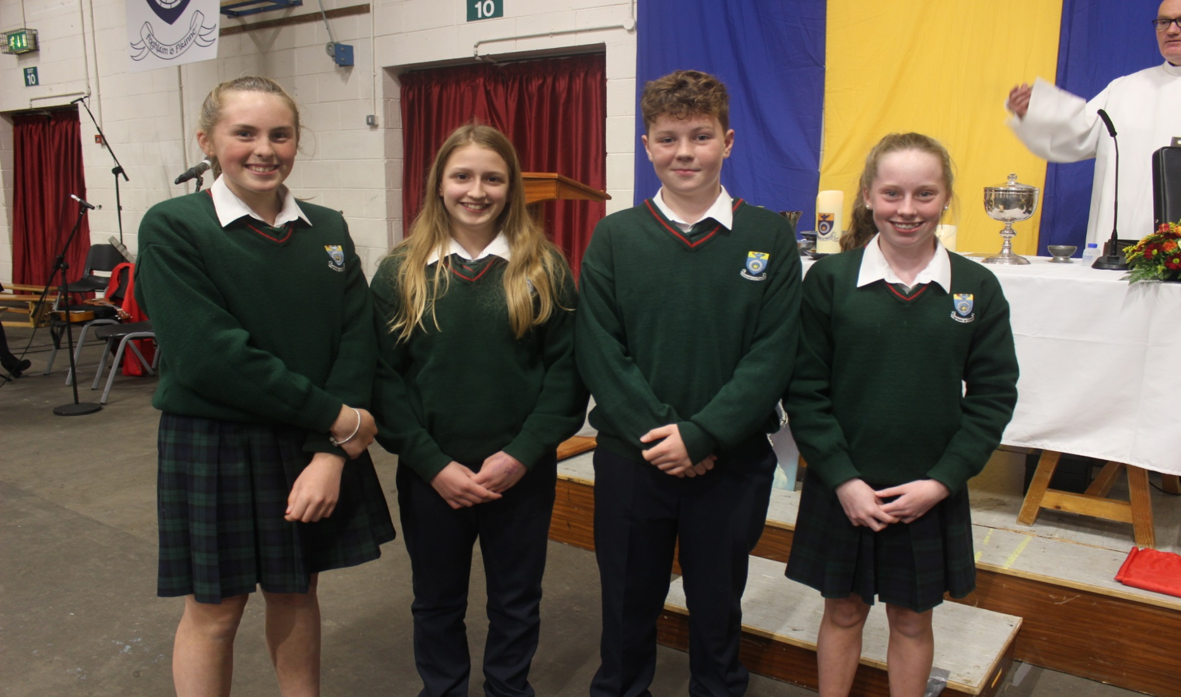
First Year Mass of Welcome

Slide 11
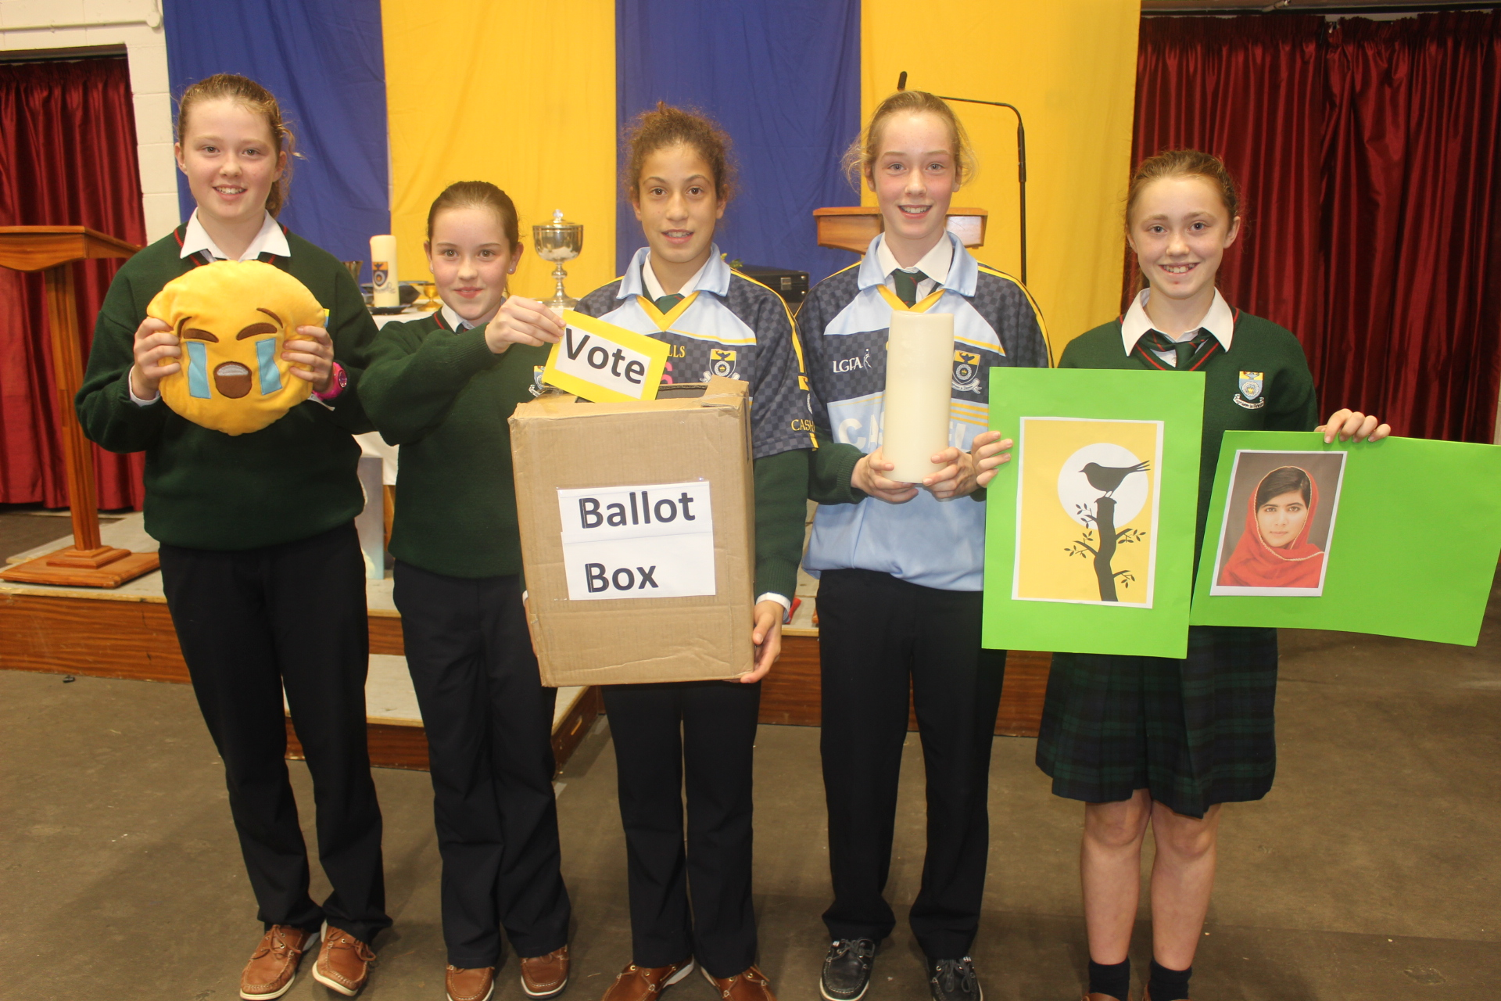
First Year Mass of Welcome

Slide 12
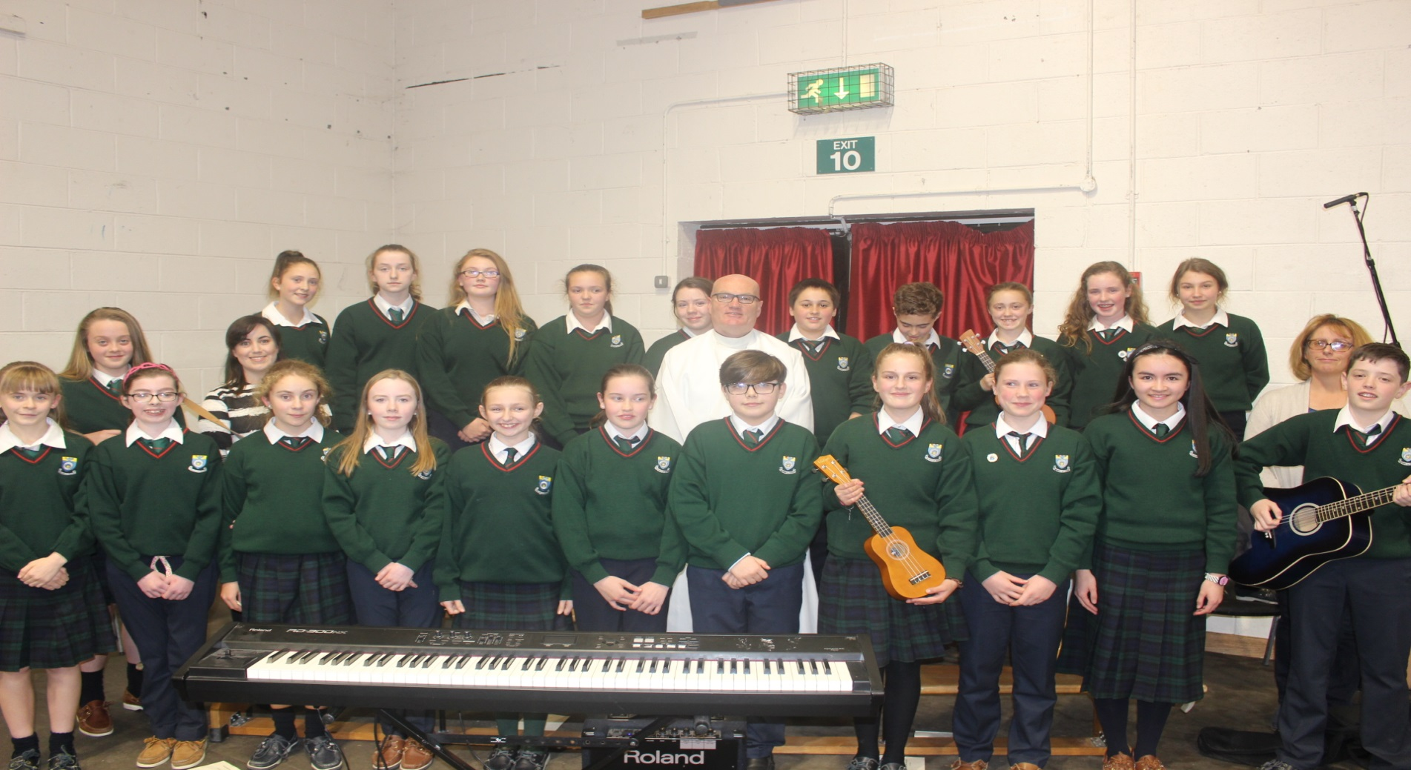
First Year Mass of Welcome

